Slide 1



B4 P2 NW
B4 P4 NR
B4 P6 R
B4 P1 B
B4 P8 BR
B4 P3 W
B4 P10 N
B4 P5 BW
B4 P7 BN
B2 P5 W
B4 P9 RW
B2 P10 BR
B3 P5 BW
B2 P4 RW
B2 P9 R
B3 P4 RW
B2 P3 BW
B3 P9 N
B2 P8 B
B3 P10 R
B3 P3 B
B2 P2 N
B3 P8 NW
B2 P7 BN
B3 P2 RB
B2 P1 NW
B3 P7 BN
B2 P6 NR
B3 P1 W
B3 P6 NR

Slide 2
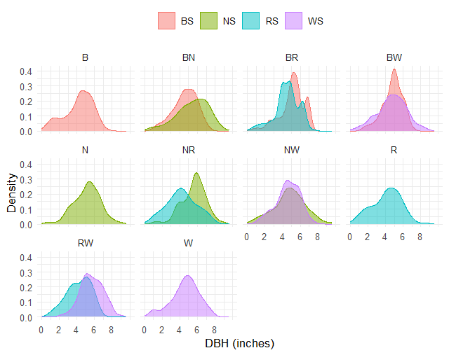
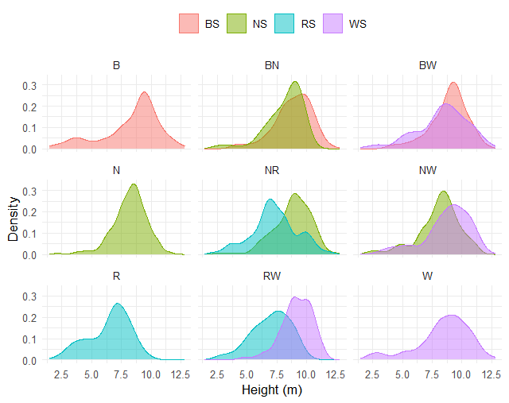

Slide 3
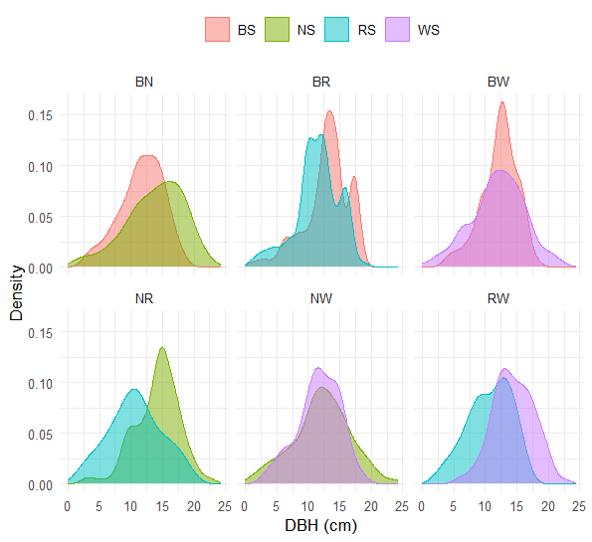
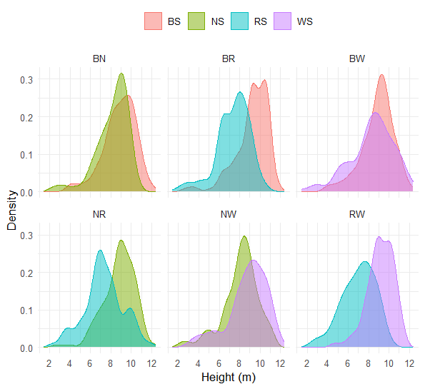
*
*
*

Slide 4
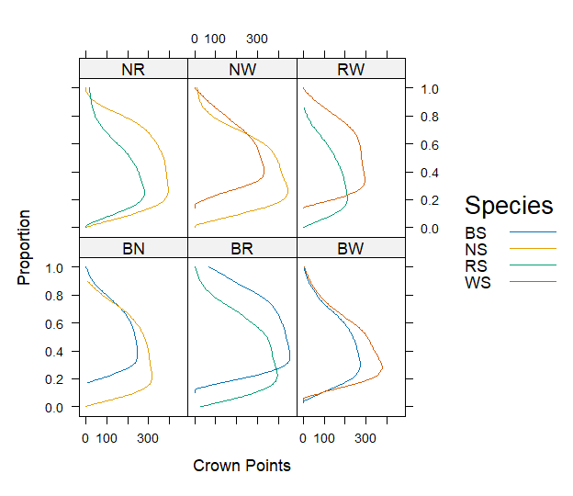
*
*
*
*

Slide 5
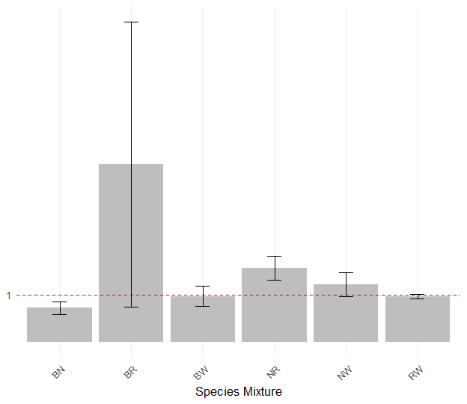
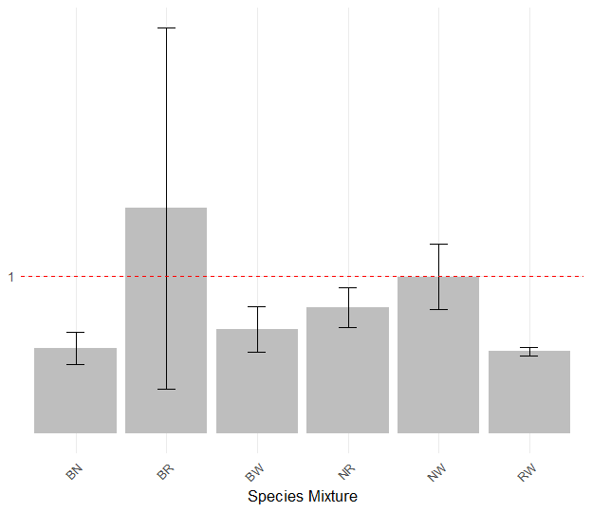
Overyielding
Transgressive Overyielding

Slide 6
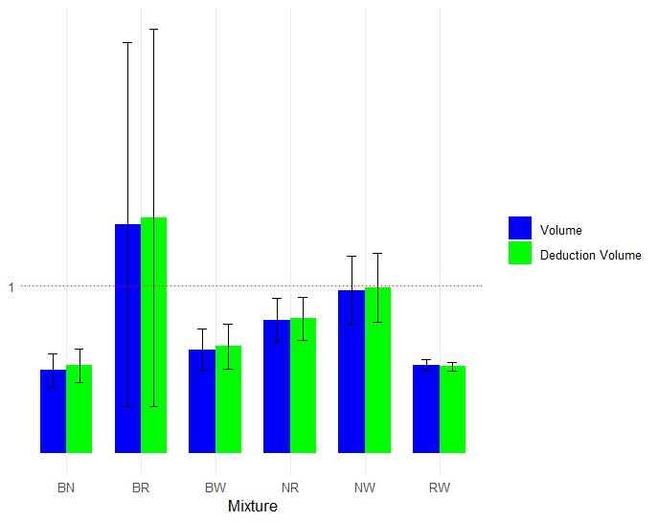
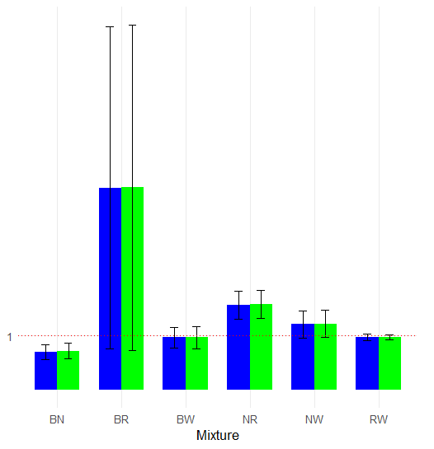
Overyielding
Transgressive Overyielding

Slide 7
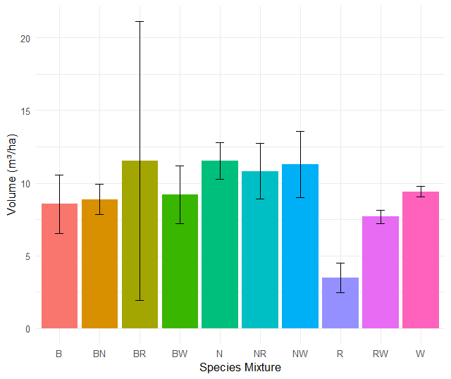

Slide 8
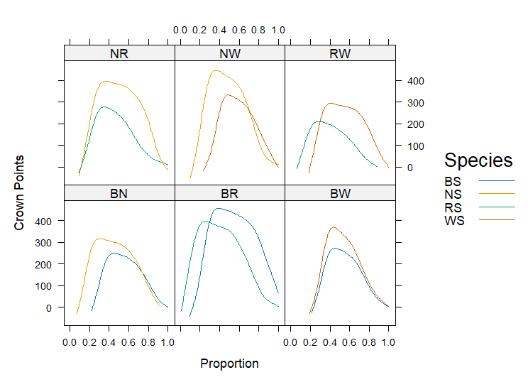
*
*
*

Slide 9
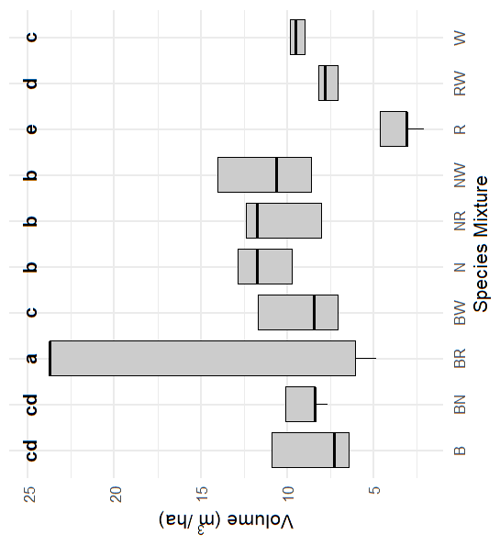
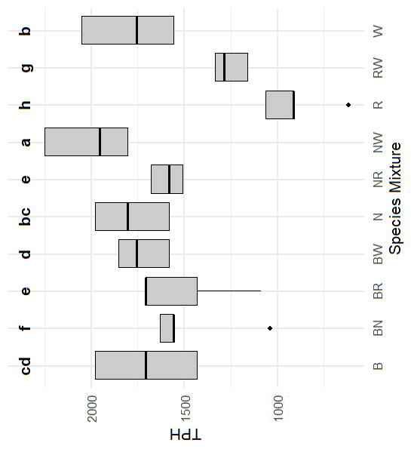
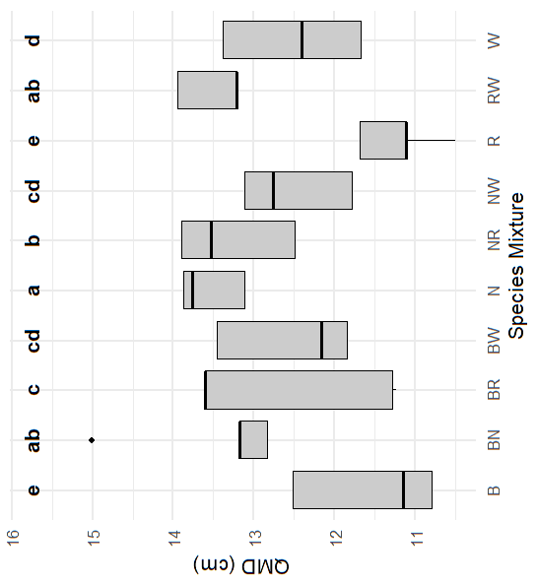
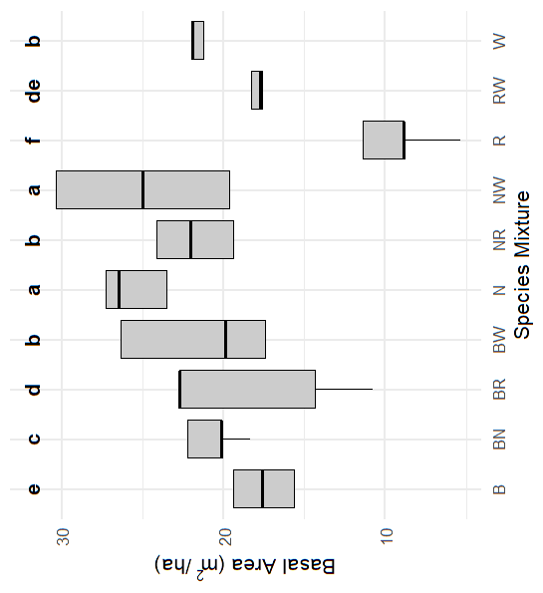
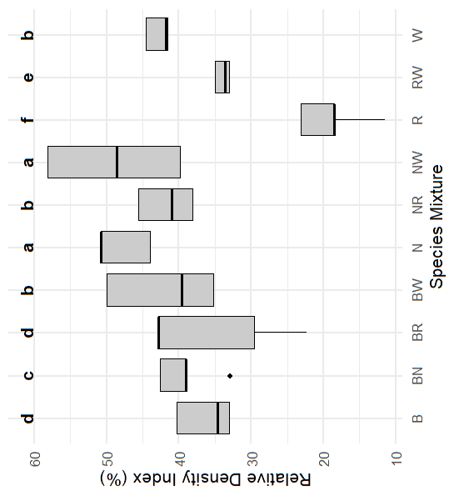

Slide 10
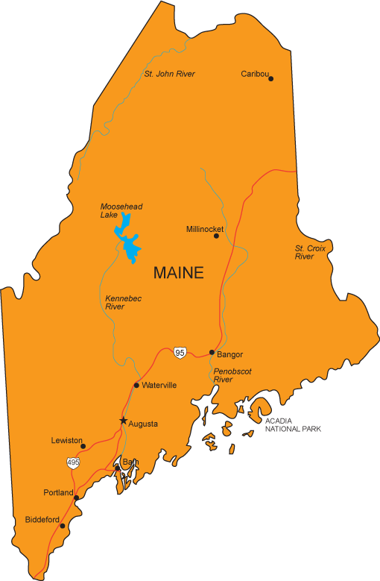
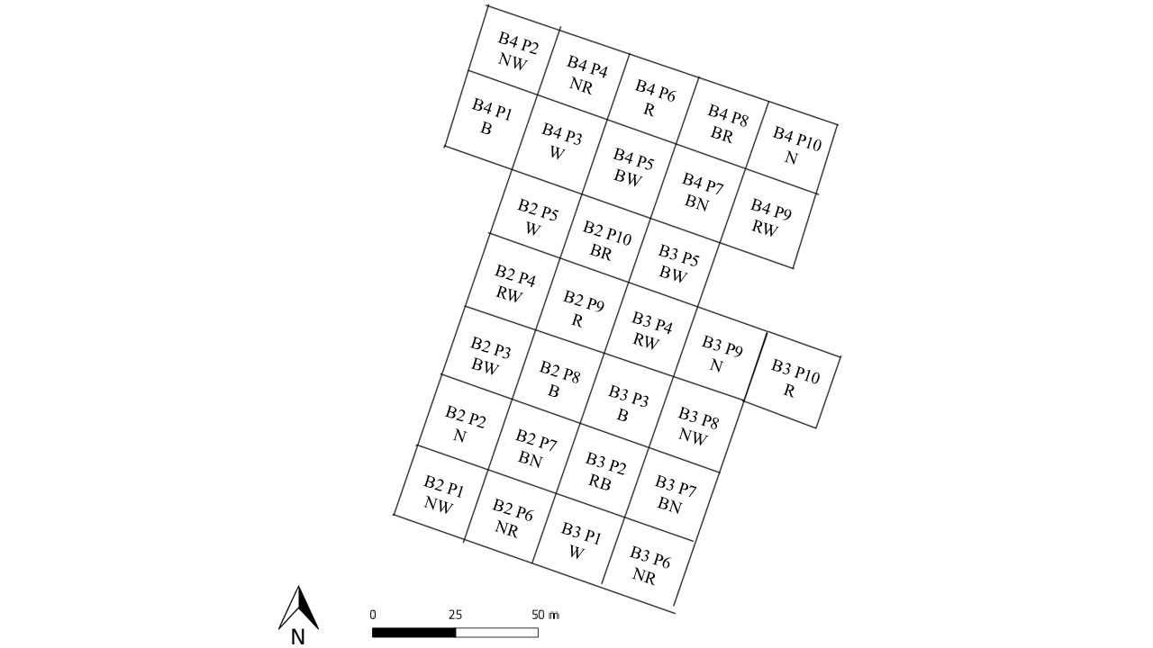

Slide 11
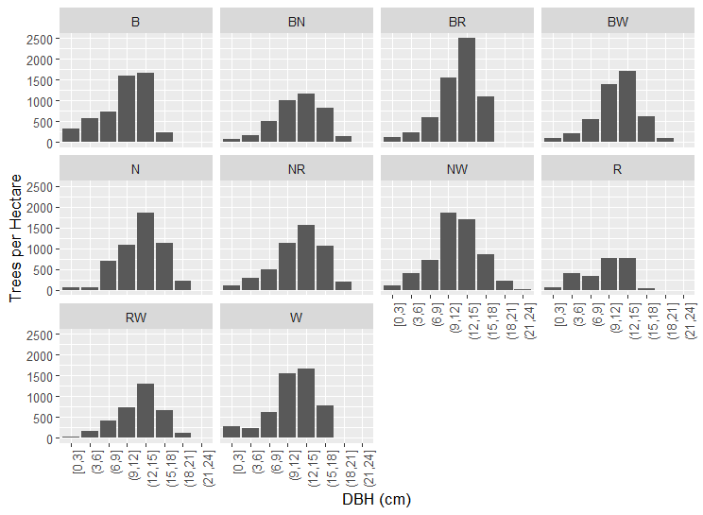
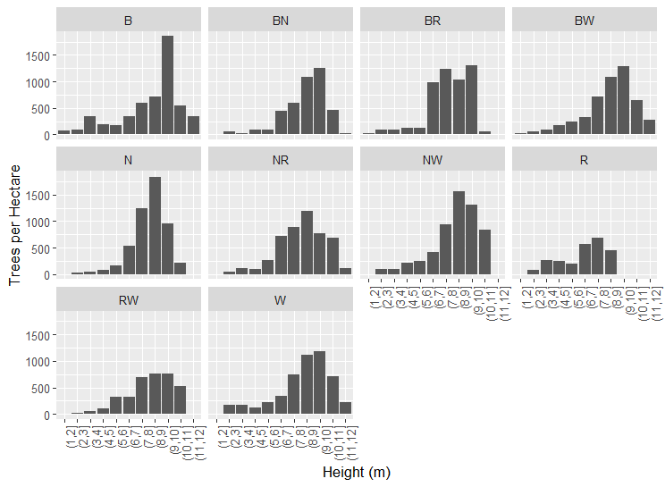

Slide 12
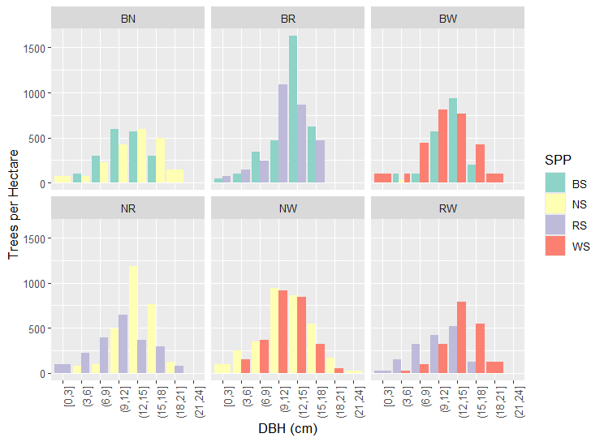
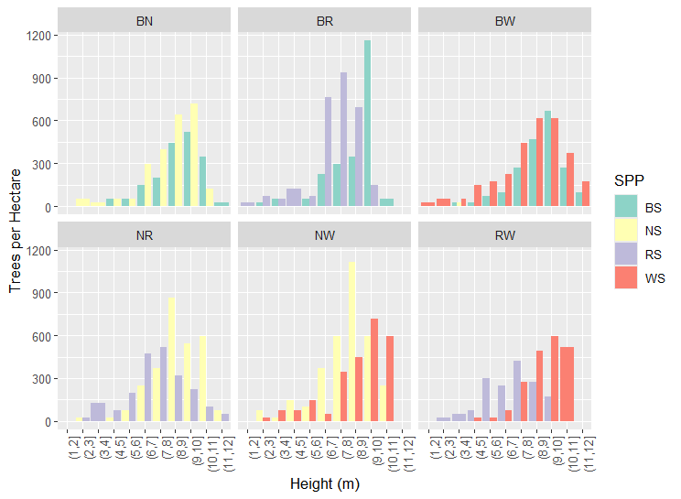

Slide 13
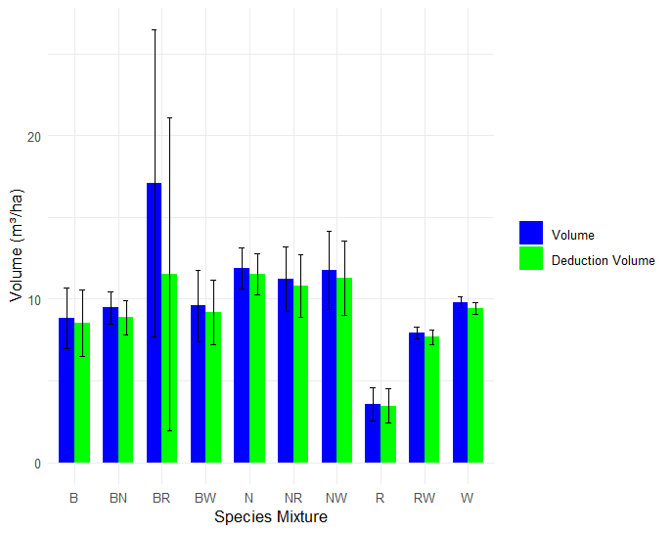

Slide 14





